Slide 1
Emergence of the Federal Funds Management Office
José J. Villamil
February, 2015

Slide 2
Brief history of Federal Funds in PR
Federal Funds represent close to 42% of GNP
7th ranked in the U.S.A.
Since the mid 70’s Federal funds have assumed greater importance in both the economy and the government.

Slide 3
Federal assistance in a nutshell
Direct payments have the highest share due to the Nutritional Assistance Program (PAN, for its Spanish acronym)
Insurance programs have different formula allocations for PR and the rest of the states
Salaries and wages and procurement contracts represent a small share
Obligations Amount
Puerto Rico
Total of
$ 29,121
Million
Notes:
Non-Competitive Grants – These include formula grants and block grants.
Cooperative Agreements – Type of assistance, similar to a grant, but requires a greater degree of involvement from the federal awarding agency in the program implementation.
Project (competitive) Grants - The funding, for fixed or known periods, of specific projects. Project grants can include fellowships, scholarships, research grants, training grants, traineeships, experimental and demonstration grants, evaluation grants, planning grants, technical assistance grants, survey grants, and construction grants.
Direct Payments for Specified Use - Financial assistance from the federal government provided directly to individuals

Slide 4
Grants with diverse effects in the economy
Over 33% of Federal funds in PR could be directly linked to programs which promote economic growth (66% social assistance).

Slide 5
Federal funds and the budget
Main grantees in Puerto Rico
59% of Grant funds in 2010
+
+

Slide 6
Competitive Grant Findings Puerto Rico
15%
Percent of grant funds that Puerto Rico receives are from competitive grant programs (Total amount of grants was $6,313 millions of which 15% are competitive grants).
Ranking of Puerto Rico (out of 51) in terms of participation in competitive grant programs.
49
Notes:
Non competitive represent 39%.
15% considering PAN

Slide 7
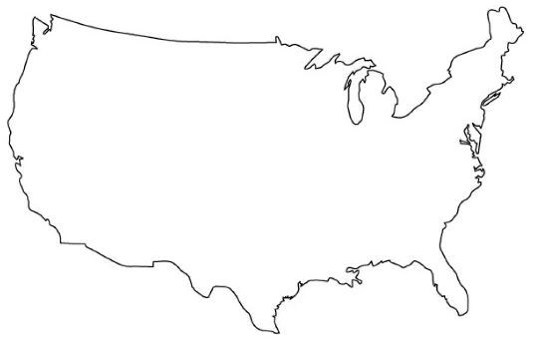
Opportunities for improvement
Federal funds per capita
FY 2010
$2,352
(average)
Per capita grant obligations
$1,695
is considerably lower when compared with that of the states; this ranks the Island at number 47
The states with the highest per capita obligations in grants were Alaska, Louisiana, Massachusetts, Vermont and Wyoming.
If the PAN is excluded from the grant analysis, Puerto Rico will be ranked in last place, with a per capita grant obligation of $1,084.
Notes:
Why Per capita analysis? To account for differences in local endowments
Socioeconomic differences in states
The opportunity for improvement lies in competitive grants

Slide 8
Facts
The majority of federal grant obligations for Puerto Rico during FY 2010 derived from non-competitive grants.
Statutory funding limits are usually concentrated in non-competitive grants in particular insurance type programs such as SSTI, Medicare and Medicaid.
If the Island was to increase its participation in competitive grant programs, it could substantially increase its current base of federal funds.
States with the highest share of competitive grants are usually the states with the highest amount of federal funds per capita.
The trend is for the Federal Government to increasingly favor competitive grants.
federal grant obligations
Notes:
Competitive grants in science and technology, business development; higher spillover effects in the economy.
Formula grants usually associated with Health and social programs.

Slide 9
Potential opportunities of funds
In terms of per capita grant participation if Puerto Rico improves as follows…
Increase to the next level (Florida)
Is ranked #25 among the 50 states, (i.e. Missouri)
Is ranked within the top 10 states in terms of competitive grants
Additional funds
$530,000,000
$1.6 billion
$3.1 billion to 5.7 billion
Not all programs have been specifically analyzed as to determine Puerto Rico’s eligibility, thus the conclusions are based on the assumption that the Island can participate in at least, most competitive grants, per the Presidential Memorandum.
*Additional funding opportunities may be limited due to eligibility considerations.
Limitations

Slide 10
Importance of Federal Funds Management Office (FFMO)
Lack of cohesion – Federal funds are decentralized at the agency or recipient level
Hence, no centralized agency responsible for management and oversight and for producing intelligence on federal government trends
Player that can connect agencies’ needs with state budget considerations
Key areas: standardize, coordinate, reduce overlaps, increase compliance, increase performance, seek new opportunities
Importance integrating federal funds into state programmatic priorities

Slide 11
Orchestrated effort to seek new opportunities
Actively seeking and competing in new funding opportunities
Develop the right incentives at the agency level
Requires improving the current management and performance of federal grants
Targeted efforts to increase the robustness of the PR’s grant infrastructure
Requires going beyond compliance
A centralized and coordinated effort is imperative
Notes:
Recipients/agencies need to compete in multiple funding opportunities, this will provide the proper know-how for future competitions and will increase the chance of winning a grant. A winning proposal is one that needs very little justification because past record evidencies execution capability. The FFMO is the key ingredient for PR’s opportunity to capture additional federal dollars. Intra-agency coordination, and maximizing the current set of federal grants is of paramout importance, taking into account the Island’s fiscal situation. 2 goals: capture new funding opportunities and maximize the use of federal funds currently received.

Slide 12
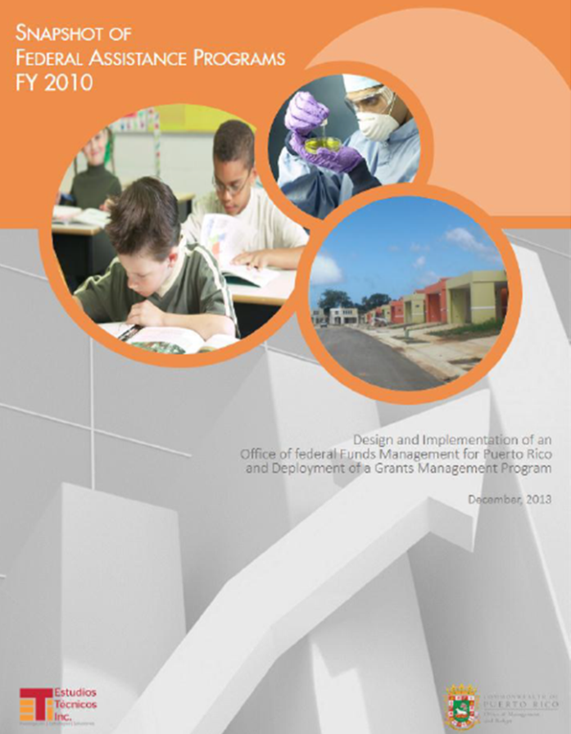
Additional information in Snapshot of Federal Assistance Programs, available in www.grants.pr.gov
José J. Villamil
Chairman of the Board
jvillamil@estudios-tecnicos.com

